Slide 1
COMP6115 Object Oriented Analysis and Design Session #13

Slide 2
Installation and Operations

Slide 3
Learning Outcomes
LO1: Identify the basic concept of advance topic in
Object Oriented Analysis and Design
LO2 : Use the knowledge to develop documentation
for object oriented software analysis and
design using Unified Modelling Language
LO3 : Analyze any problem in any software
application and find out the alternative
solutions using object oriented analysis and
design approach

Slide 4
Chapter 13: Installation and Operations

Slide 5
Objectives
Be familiar with the system installation process.
Understand different types of conversion strategies and when to use them.
Understand several techniques for managing change.
Be familiar with post-installation processes.

Slide 6
Introduction
Managing the change to a new system is one of the most difficult tasks in any organization
Conversion planning normally begins while the programmers are still coding
Change management focuses on people
Maintenance can account for 60-80% of IS budget

Slide 7
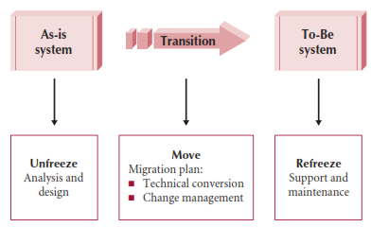
A Model for Implementing Change

Slide 8
Cultural Issues and Information Technology
Factors that may affect adoption/acceptance of technology
Speed of messages—may affect documentation & training
Context: high context societies need to see how the new system fits in to existing systems
Time: poly-chronic vs. mono-chronic (similar to parallel vs. serial)
Power distance—can a subordinate point out errors?
Uncertainty avoidance—related to risk and stress caused by change
Individualism vs. collectivism—who is more important: the individual or the group?
Masculinity vs. femininity
Long- vs. short-term orientation—which is the focus: long term relationships or short term profits?

Slide 9
Conversion
Conversion is the technical process by which a new system replaces an old system
Three major steps to a conversion plan
Buy & install hardware
Install software
Convert data
Conversion dimensions
Conversion style—direct or parallel
Conversion location—pilot, phased or simultaneous
Conversion modules—whole system at once or one module at a time

Slide 10
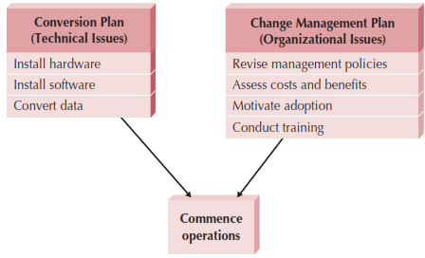
Elements of Migration Plan

Slide 11
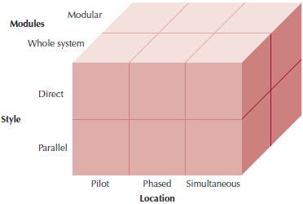
Conversion Strategies

Slide 12
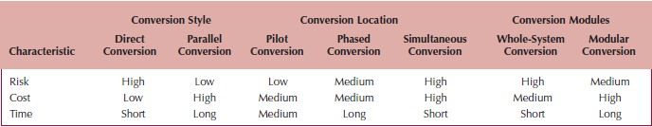
Selecting Conversion Strategies
Combine dimensions to form a strategy as needed
Example: Begin with a pilot conversion using parallel conversion in a handful of locations; once successful, roll out to remaining locations using phased conversion
Prioritize risk, cost, and time; then refer to chart

Slide 13
Change Management
The process of helping people adopt & adapt to the to-be system and its accompanying work processes without undue stress
Key roles
Sponsor
Change agent
Potential adopters
“Build it and they will come” doesn’t work!

Slide 14
Resistance to Change
What is good for the organization is often not good for the people in it
People perform their own personal cost-benefit analysis
Perceived costs & benefits are weighted by the amount of uncertainty associated with them
Most will overestimate costs and underestimate benefits
Must take into account the transition process cost
Perceived costs and benefits are more important than real costs and benefits

Slide 15
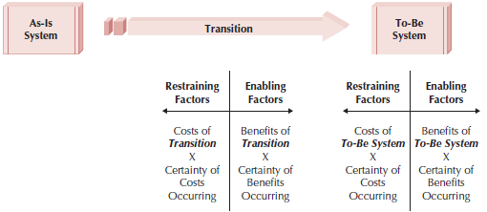
Costs & Benefits of Change

Slide 16
Revising Management Policies
Management policies
Provide goals
Define how work processes should be performed
Determine how people are rewarded
No computer system will be successfully adopted unless management policies support its adoption

Slide 17
Work Process Structuring Tools
Standard Operating Procedures
SOPs must be revised to match the to-be system
Measurements and Rewards
Design to motivate desired (acceptance) behavior
Resource Allocation
Direct effect is the actual reallocation of resources
Symbolic effect shows that management is serious about the new system

Slide 18
Assessing Costs & Benefits
Develop a list of costs & benefits from two perspectives: the organization & the potential adopters
Consider the effects on both end-users and managers
Goal is to persuade those who might resist to support the change
Significant management changes may be required to prevent grassroots derailing efforts
A successful organization may find it harder to manage change
People need to be convinced that was has worked in the past may not work in the future

Slide 19
Motivating Adoption
Provide clear and convincing evidence of the need for change
Two basic strategies to motivate adoption
Informational strategy
Political strategy
Change management goal is to support and encourage the ready adopters and help them win over the reluctant adopters

Slide 20
Enabling Adoption: Training
Provide the skills needed to adopt the change
Don’t assume the system is so simple to learn that new users need no training
What to train?
Training should not focus on using the system
Training should focus on helping the users accomplish their jobs
Training should focus on what the user needs to do, not what the system is capable of doing
How to train?
In groups in a classroom
One on one
Computer based training (CBT)

Slide 21
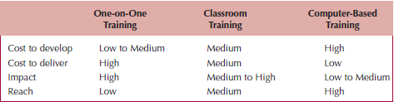
Selecting Training Methods

Slide 22
Post-implementation Activities
Goal is to institutionalize the new system
Make it the normal & accepted routine
“Refreeze” the organization after successful transition
Usually the job of the project sponsor and manager
Actively promote its use and monitor its adoption
Provide steady flow of information to users to encourage use

Slide 23
System Support
Now transition from project team to an operations group
Responsible for operating the system & providing system support
Types of system support
On-demand training
Online support (e.g., documentation & FAQs)
Help desk to provide expert advice
Level I support should satisfy 80% of problems
Unable to solve at level I:
Generate problem report or ticket
Escalate to Level II

Slide 24
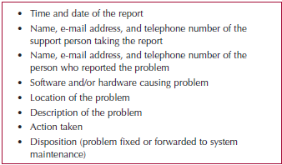
Elements of a Problem Report

Slide 25
System Maintenance
The process of refining the system to make sure it continues to meet business needs
More expensive than initial development
Novice system analysts & programmers will work on maintenance projects
Change requests are smaller versions of a system request
Requests may come from a number of different sources
Problem reports
Users
Other projects
Underlying software (e.g., Operating System changes)
Senior management

Slide 26
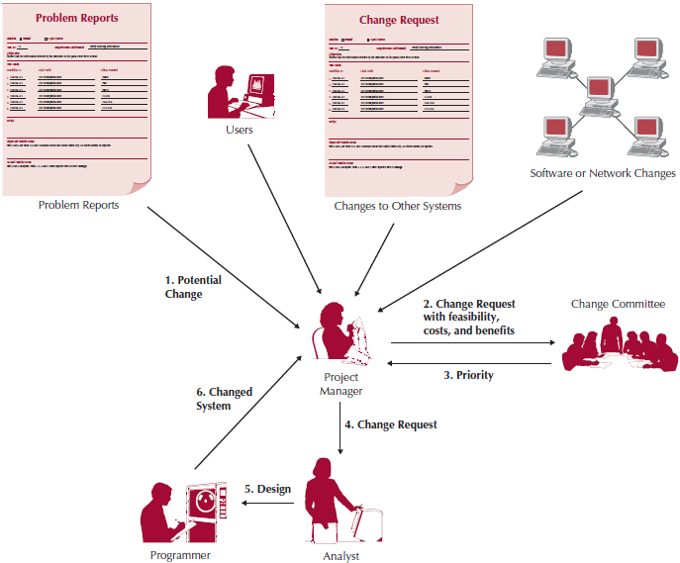
Processing a Change Request

Slide 27
Project Assessment
Determine what was successful and what needs to be improved
Project Team Review
Members list what worked and mistakes that were made
Goal is to repeat excellent performance and eliminate mistakes
Project manager can prepare a “lessons learned” document
System Review
To what extent did the proposed costs & benefits actually accrue
Goal is to compare estimates with actual values
Determine whether or not the system provides the expected value
Provide baseline costs for future projects

Slide 28
Summary
Cultural Issues and Information Technology
Conversion
Change Management
Post-implementation Activities

Slide 29
References
Denis, Wixom,Tegarden. (2015). Systems Analysis and Design: An Object-Oriented Approach with UML. 5th edition. ISBN: 978-1-118-80467-4, John Wiley & Sons, Inc, Denver (USA)

